Slide 1

Hooghly Engineering & Technology College
DEPARTMENT OF COMPUTER SCIENCE AND ENGINEERING
Research Methodology PROJ CS601
Stock Market Web Scraper
Arkodip Das (17600121022)
Subhadip Samanta (17600121065)
Sandeep Mondal (17600121113)
Kousik Biswas (17600121063)

Slide 2
Table of Contents
01
02
3 - 10
11-12
Problem Statement
Introduction to the problem along with the suitable solution
Aim and Scope
Detailed analysis of the model along with its aim and objectives
Theoretical Analysis
Explanation of the model along with suitable tech stack requirements
Conclusion and Future Consideration
Concluding factors and discussion related to future enhancements

Slide 3
Problem Statement
Businessmen and investors often need to analyze stock market data to make informed decisions. However, manually collecting and processing this data can be a time-consuming and tedious task.
The goal of this project is to develop a web scraper using Python that can automatically retrieve stock data from financial websites and provide meaningful insights through data visualization.
01

Slide 4
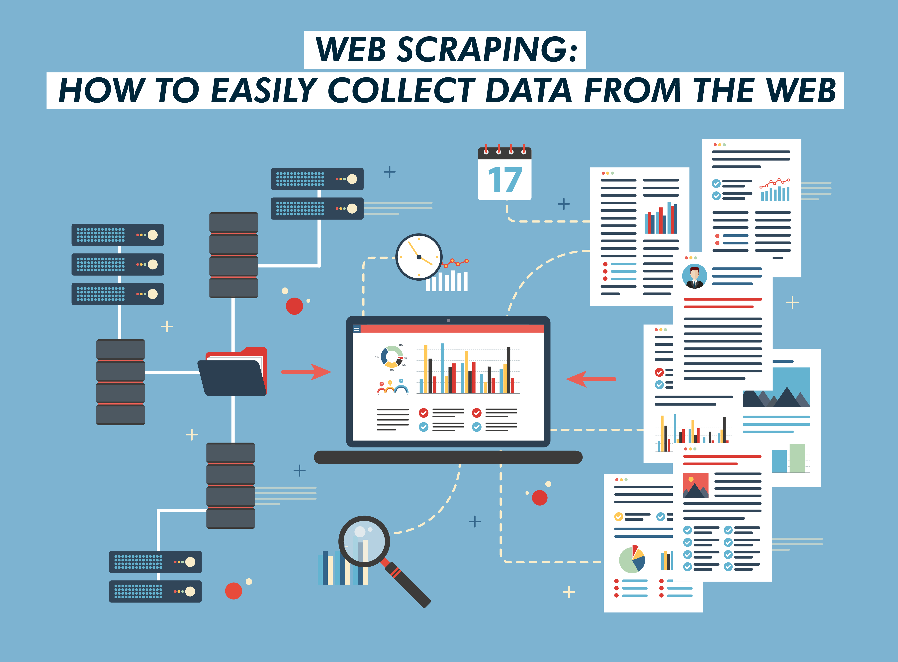
Aim and Scope
The aim of this project is to
Develop a robust web scraper using Python
Efficiently extract real-time stock market data from financial websites.
Ensure smooth collection, cleaning, and analyzing stock price trends and patterns to provide valuable insights for investors and market analysts.
The project will leverage powerful Python libraries such as yfinance, Pandas, and Matplotlib to achieve these goals.
02

Slide 5
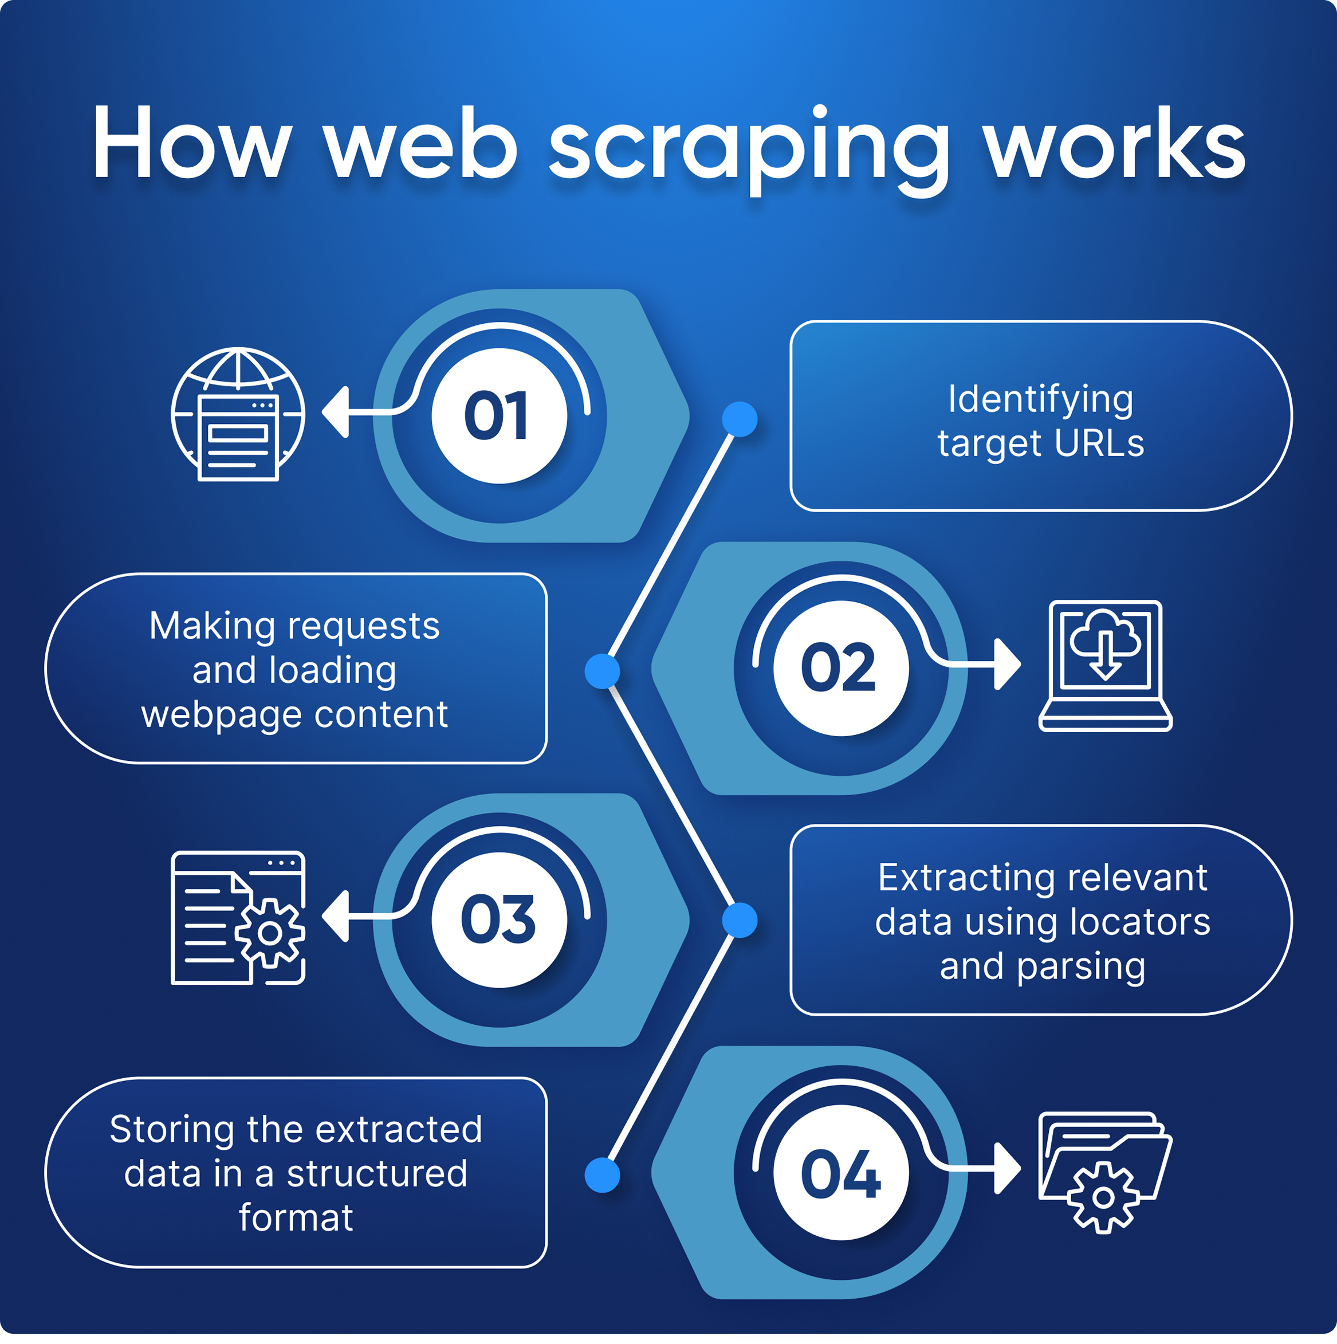
Theoretical Analysis
Introduction
Web scraping is the process of extracting data from websites or webpages using automated software. It allows us to gather large amounts of raw data quickly and efficiently, providing valuable insights for business analysis and research.
03

Slide 6
Stock Market Web Scraper
Data Collection: Scrape real-time stock data, financial reports, and market news from reliable sources to build a comprehensive dataset.
Data Structuring: Using yfinance to access the raw HTML data of yahoo finance.
Data Cleaning: Clean and standardize the data, handling missing values, and ensuring consistency across different sources.
Analysis Preparation: Transform the data into a format that can be easily analyzed, such as pandas data frames also using matplotlib
04

Slide 7
Scraping Procedures
HTML Data extraction
Using yfinance library to access raw html data from yahoo finance.
Data Storage
Data structuration is achieved
Data Visualization
Using Python Libraries(Pandas and Matplotlib) to present the data visually
Statistical Analysis is done mainly with the help of graphs(line graphs, bar graphs, etc).
05

Slide 8

Data Extraction using Yahoo Finance
Access up-to-date data
yfinance can fetch real-time stock price data, which is crucial for traders and investors who need the latest information to make informed decisions.
Simple Integration
It integrates seamlessly with popular data analysis libraries like pandas, making it easy to manipulate and analyze the data.
Free Access
yfinance is free to use, which is a significant advantage compared to many other financial data services that require expensive subscriptions.
06

Slide 9
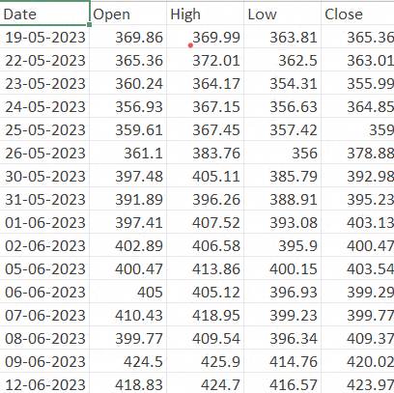

Data Manipulation with Pandas
Data Ingestion
Load the scraped data into pandas data frames for easy manipulation and analysis.
Data Transformation
Clean, filter, and reshape the data to suit our analysis needs.
Data Cleaning
Sanitize the extracted data, removing unwanted formatting and ensuring consistent data types.
07

Slide 10
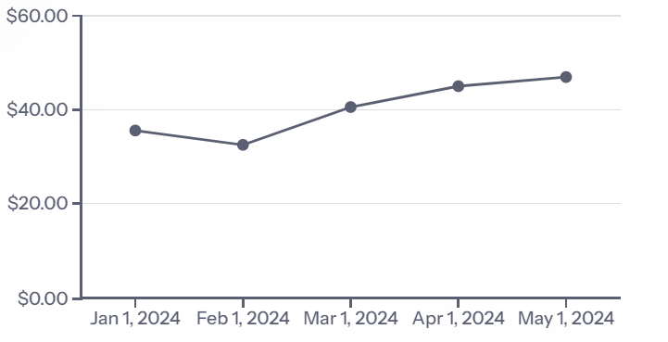
Visualizing Insights with Matplotlib
To better understand the trends and patterns in the stock market data, we will utilize Matplotlib, a powerful data visualization library in Python. Matplotlib allows us to create a variety of charts and graphs to effectively communicate the insights from the data.
The line chart above illustrates the stock price fluctuations over a 5-month period, providing a clear visual representation of the trends in the data.
08

Slide 11
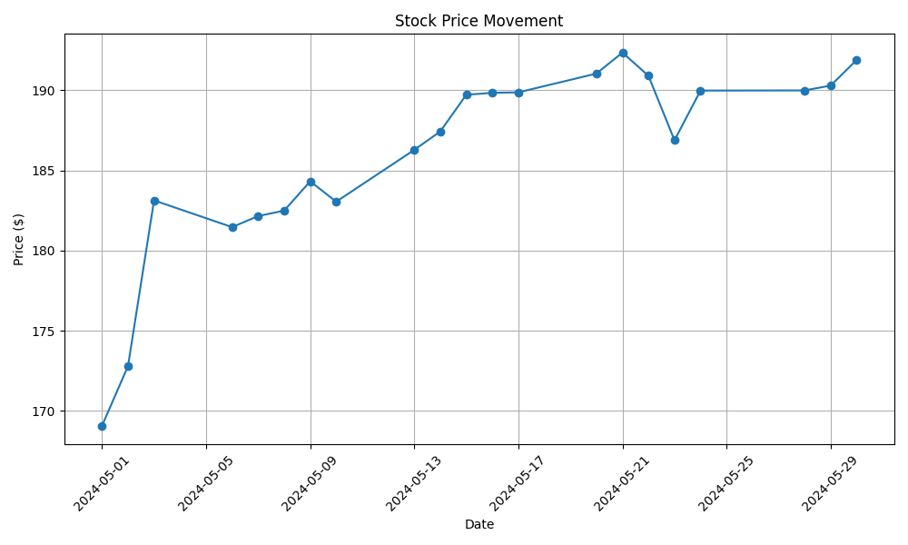
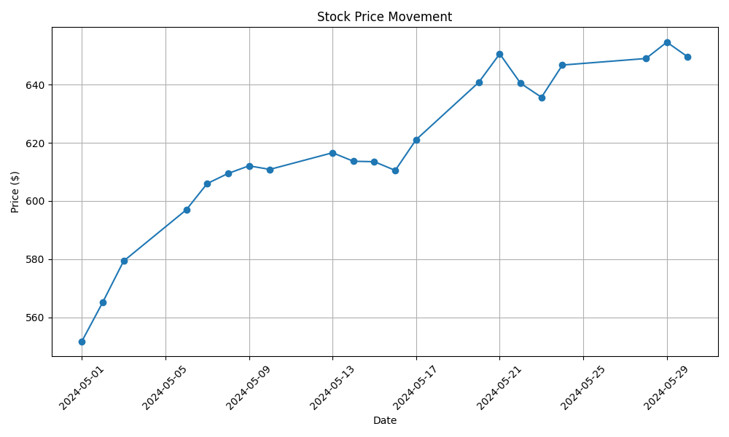
Visualizing stock closing prices of organizations(Apple and Netflix)
09

Slide 12
Analyzing Stock Market Trends and Patterns
Identifying Trends: By analyzing historical stock data, we can identify long-term trends which help investors make informed decisions about when to buy, hold, or sell stocks.
Detecting Patterns: Stock market data often exhibits recurring patterns, such as seasonal fluctuations or the influence of economic events. Recognizing these patterns can provide valuable insights.
Charting Price Movements: Visualizing stock prices over time using charts and graphs can reveal important information about a company's performance and the overall market conditions. This helps investors understand the risks and opportunities associated with specific stocks.
Analyzing Volatility: Measuring the volatility of stock prices can help investors assess the risk associated with a particular investment and make more informed trading decisions. High volatility can present opportunities for significant gains, but also carries greater risk.
10

Slide 13
Conclusion
In this project, we successfully developed a comprehensive stock market web scraping tool using Python, leveraging the capabilities of yfinance, Pandas and Matplotlib. Our objective was to automate the extraction, analysis, and visualization of stock market data to provide insightful trends and patterns that can aid in investment decisions.
Furthermore, this project has demonstrated the power and flexibility of combining web scraping, data analysis, and visualization techniques to gain actionable insights into the stock market. The skills and methodologies employed here lay a solid foundation for more advanced financial analytics and predictive modeling in future projects.
11

Slide 14
Future Considerations
Integrating an User friendly interface
A potential user interface could be integrated using the python code as backend which would enhance the user experience.
Ethical Considerations
As web scraping can raise privacy concerns, it's crucial to follow best practices and respect website terms of service to ensure ethical and legal data collection.
Wider Applications
The skills and techniques developed in this project can be applied to scrape and analyze data from various industries, opening up new opportunities for data-driven decision making.
12

Slide 15
Thank You !!

